Slide 1

Data-Driven Demand and Sales Prediction of an Electric Appliance Store
Business Data Management Capstone Project
Trivedhan Sivaprakash
21F1001724

Slide 2
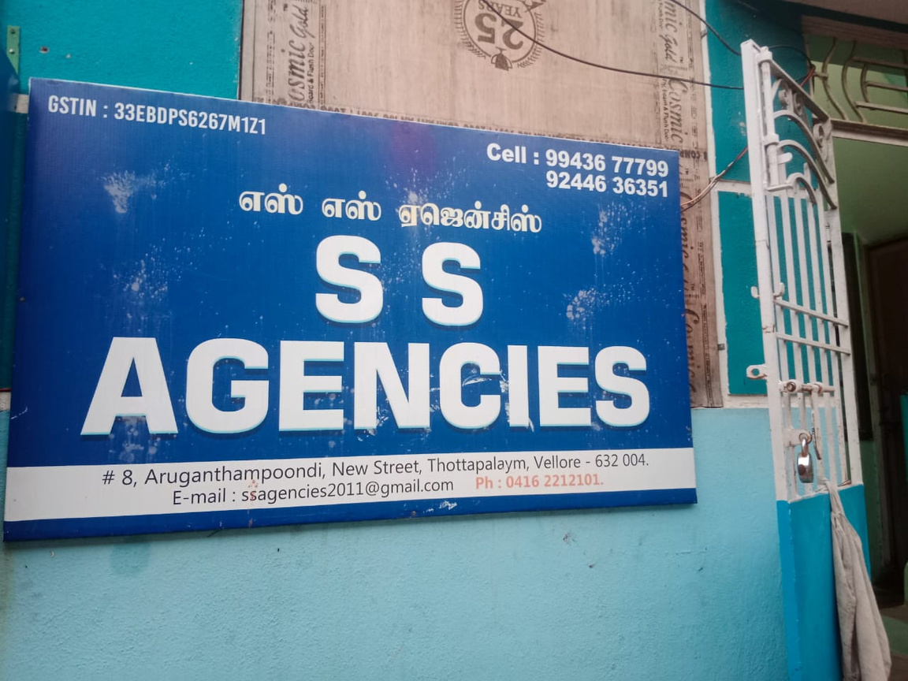
About the Supplier
Om Muruga S.S Agencies are suppliers who purchase and sell electrical appliances like Water Heaters, Stabilizers, Fans, Mixers and Grinders from leading manufacturers like V-Guard, Havell’s,etc.
It was established in the year 2010 and is based in the Vellore district of Tamil Nadu.
They supply to over 300+ electronics dealers across Vellore and its neighboring districts
They also have authorized mechanics who provide services for Product Installation, repair and maintenance of their products free of cost to customers.

Slide 3
Problems Faced by the Supplier
Due to Onset of COVID, the business sales had fallen down.
The Sales are yet to reach the Pre-Covid Amount.
Problem Statement
To perform a Data Analysis on the Sales and Demand Orders for the Organization and identify important trends.
To perform a Forecasting on Sales and Purchase Orders Made by the Organization.

Slide 4
Primary Data Source
Sales Order Dataset
The Sales dataset outlines the customer’s request to purchase the respective goods from their organization.
Dataset was procured for the timespan of 1st January, 2023 - 30th June 2023
Purchase Order Dataset
The Purchase dataset outlines the Organization’s request to purchase the respective goods from its vendors.
Dataset was procured for the timespan of 1st January, 2023 - 30th June 2023

Slide 5
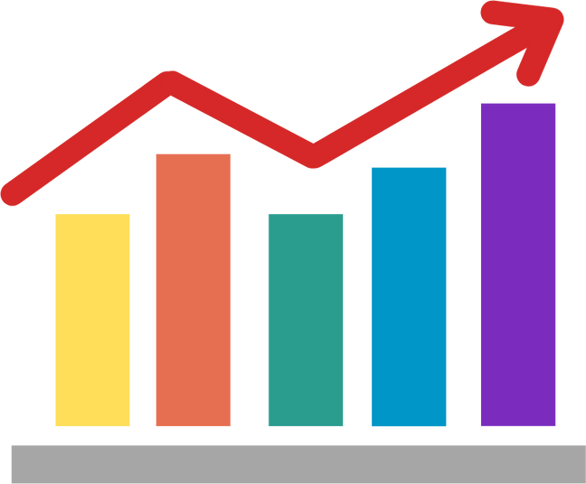
Data Analysis on Sales Dataset
Most of the purchases made from Ohm Service Center lie in the range of INR 4000 – INR 8000.
Most frequent as well as the greatest number of purchases are made by customers on demand rather than on bulk by some external distributors.
Even though in-demand purchases tend to be the most in frequency, external distributors purchase items with more expense.
Tuesdays tend to be their busiest days whereas Saturdays tend to have reduced number of sales.

Slide 6
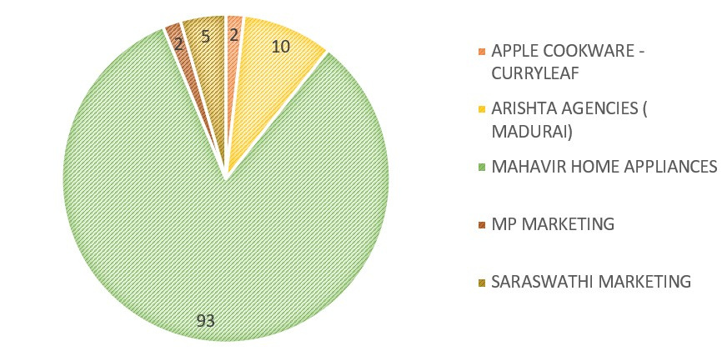
Data Analysis on Purchase Dataset
Most of the purchases made by Ohm Service Center lie in the range of INR 400 – INR 40,000.
There were only 5 vendors from which offers the products. Out of which, there is an over 83 % dependence in one of the Vendors in contrast to others.
There is a variation in the purchase amount with respect to the month, but the average purchase amount spent per month remains the same.

Slide 7
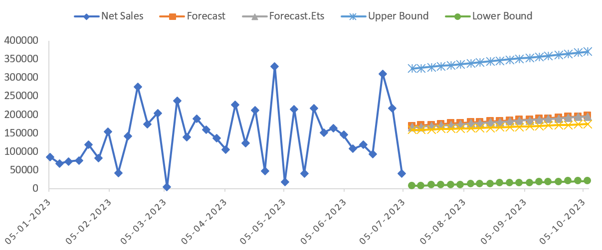
Forecasting of Sales Order
The Sales Forecast predicts an increasing demand thereby resulting in a rise of further purchase by vendors.

Slide 8
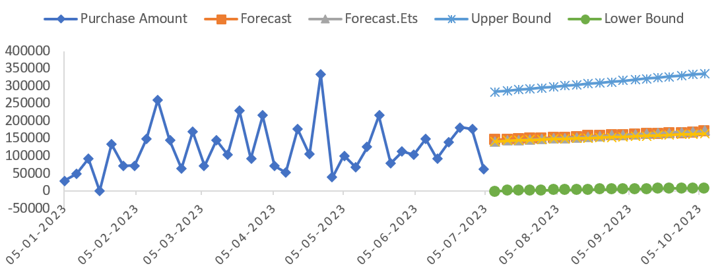
Forecasting of Purchase Order
The Purchase Forecast predicts a stagnation in purchase by the Service Center. This creates a mismatch with the Sales Order Prediction.

Slide 9

Key Recommendations
There exists a disparity between the Sales and the Purchase Order. This can result in increase of demand without a corresponding increase in the supply. Key suppliers need to be notified of this to increase the purchase. Suppliers can be offered incentives and other bulk discounts to increase the goods.
The single vendor dependency for the goods must be reduced. The supplier base needs to be diversified to create a really stable supply chain.
In-demand purchases are greater than bulk purchases, critical items need to be prioritized to meet up with the immediate needs. The most purchased item in the in-demand purchases needs to be in high stock.
The service center sees a higher sale on Tuesday than the other days by a margin of 25%. This means there can be drives to increase the customer sales on other days as well. Staff levels needs to be optimized to accommodate the higher purchases on Tuesdays.

Slide 10



